Slide 1
Docker Architecture

Slide 2
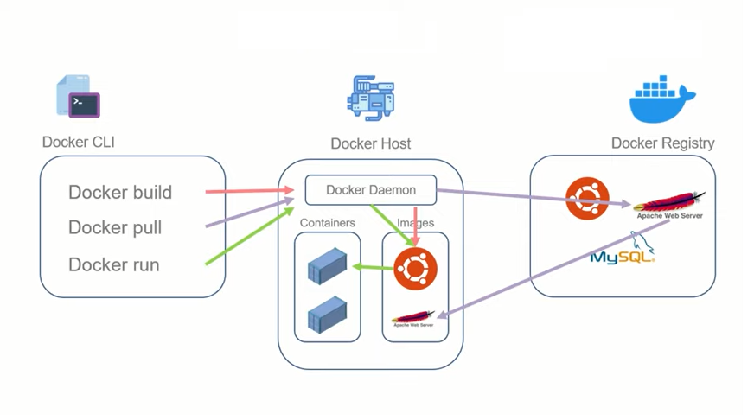
Docker Architecture

Slide 3
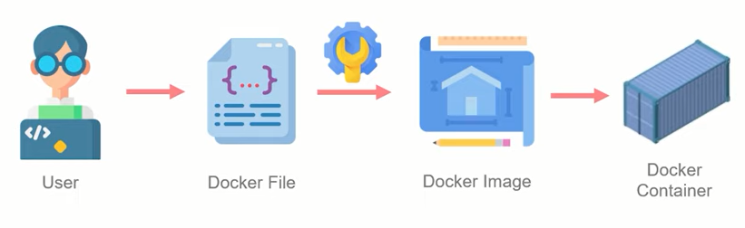
Docker File
Docker Files are basically scripts that you can write and then build into a Docker Image. The image can then be run to create the Container. Its like a Shell script.

Slide 4
Dockerfile Instructions
FROM
ADD
COPY
RUN
WORKDIR
CMD
VOLUME
EXPOSE
ENTRYPOINT
LEBEL
FROM
Syntax: FROM <base_image_name>
It is an instruction that informs docker about the base image that is to be used for the container. So basically, if you have an image in mind whose properties you wish to inherit you can mention it using this instruction.
This is always used as the first instruction for any docker image, but you can use it multiple times.
ARG is the only instruction that may precede FROM in dockerfile.
Example:
FROM ubuntu:latest

Slide 5
Dockerfile Instructions
FROM
ADD
COPY
RUN
WORKDIR
CMD
VOLUME
EXPOSE
ENTRYPOINT
LEBEL
ADD
Syntax: ADD <source> <destination>
It is used to add new sources from your local directory or a URL to the file system of the image that will become the container in the designated locations.
You can include multiple items as the source and can even make use of wildcard and if the destination that you have mentioned does not exit then it will create one.
Example:
ADD test.txt ./app
ADD --keep-git-dir=true https://github.com/moby/buildkit.git#v0.10.1 /buildkit

Slide 6
Dockerfile Instructions
FROM
ADD
COPY
RUN
WORKDIR
CMD
VOLUME
EXPOSE
ENTRYPOINT
LEBEL
COPY
Syntax: COPY <source> <destination>
It is used to copy new sources from only your local directory to the file system of the image that will become the container in the designated locations.
You can include multiple items as the source and can even make use of wildcard and if the destination that you have mentioned does not exit then it will create one.
It’s like ADD, the difference being that ADD can also add new URL to the file system whereas COPY can’t.
Best practice is to use COPY instruction instead of ADD.
Example:
COPY test.txt ./app

Slide 7
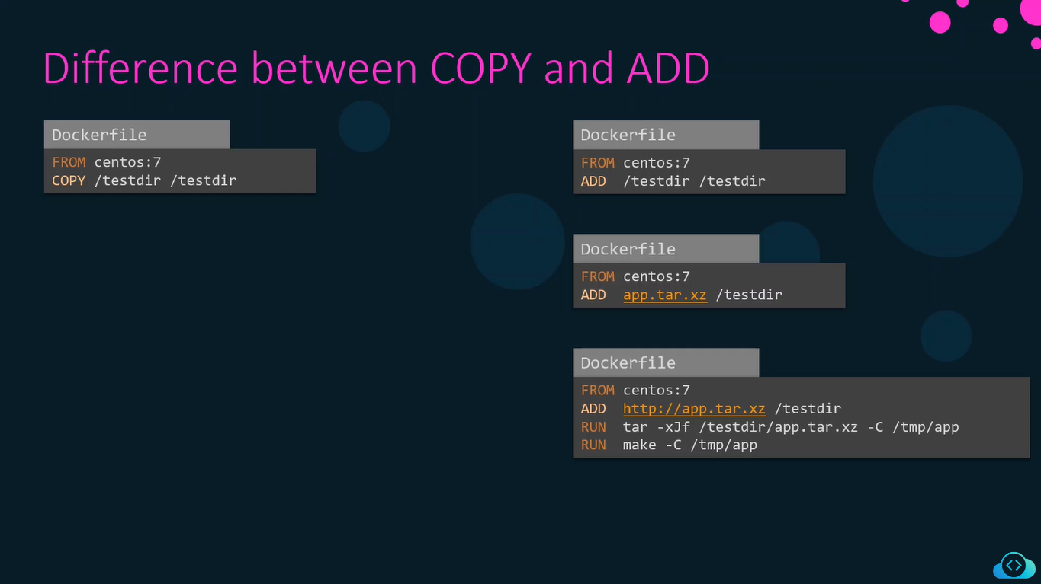
COPY is more efficient because it only copies files without any extra processing. ADD, on the other hand, may unintentionally increase image size by downloading remote files or extracting compressed files, which can complicate the build process.

Slide 8
Dockerfile Instructions
FROM
ADD
COPY
RUN
WORKDIR
CMD
VOLUME
EXPOSE
ENTRYPOINT
LEBEL
RUN
Syntax: RUN <command>
This instruction is used to run specific commands that you want to run in the container during its creation. For example, you want to update the ubuntu instance then you can use the instruction such as:
Example:
RUN apt-get update

Slide 9
Dockerfile Instructions
FROM
ADD
COPY
RUN
WORKDIR
CMD
VOLUME
EXPOSE
ENTRYPOINT
LEBEL
WORKDIR
Syntax: WORKDIR <directory>
This instruction is responsible for setting the working directory so that you can run shell commands in that specific directory during the build time of the image.
Example:
WORKDIR /app

Slide 10
Dockerfile Instructions
FROM
ADD
COPY
RUN
WORKDIR
CMD
VOLUME
EXPOSE
ENTRYPOINT
LEBEL
CMD
Syntax: CMD <command>
This instruction tells the container what command to run when it gets started.
The difference between RUN and CMD is that RUN instruction executes command at the time of creating container while CMD instruction executes command after container gets created.
There can only be one CMD instruction in a Dockerfile. If you list more than one CMD then only the last CMD will take effect.
Example:
CMD /app

Slide 11
Dockerfile Instructions
FROM
ADD
COPY
RUN
WORKDIR
CMD
VOLUME
EXPOSE
ENTRYPOINT
LEBEL
VOLUME
Syntax: VOLUME <path>
This instruction makes a mount point for the volume of a specified name.
Example:
VOLUME /myvol

Slide 12
Dockerfile Instructions
FROM
ADD
COPY
RUN
WORKDIR
CMD
VOLUME
EXPOSE
ENTRYPOINT
LEBEL
EXPOSE
Syntax: EXPOSE <ports>
This instruction tells what port the container should be exposed at. But this can only happen for an internal network, the host will not be able to access the container from this port.
Example:
EXPOSE 80/tcp
EXPOSE 80/udp

Slide 13
Dockerfile Instructions
FROM
ADD
COPY
RUN
WORKDIR
CMD
VOLUME
EXPOSE
ENTRYPOINT
LEBEL
ENTRYPOINT
Syntax: ENTRYPOINT <command> <parameter 1> <parameter 2>
This instruction allows you to run commands with parameters when your container starts.
The difference between CMD and ENTRYPOINT is that with ENTRYPOINT your command is not overwritten during runtime. When you use ENTRYPOINT it will override any elements specified in another CMD instruction.
Example:
ENTRYPOINT ["top", "-b"]

Slide 14
Dockerfile Instructions
FROM
ADD
COPY
RUN
WORKDIR
CMD
VOLUME
EXPOSE
ENTRYPOINT
LABEL
LABEL
Syntax: LABEL <key>=<value>
This instruction is used to add meta data to your image. You need to make use of quotes & backslashes if you want to include spaces. If there are any older labels, they will be replaced with the new label value. You can make use of Docker inspect command to see its container.
Since a new layer is created each time, a new instruction is written, it is important to write in the most optimized way as possible and least number of instructions as possible.
Example:
LABEL vender1=ACM

Slide 15
Dockerfile Instructions
ENV
USER
ARG
ONBUILD
STOPSIGNAL
HEALTHCHECK
SHELL
ENV
Syntax: ENV <key>=<value>
The ENV instruction sets the environment variable <key> to the value <value>. This value will be in the environment for all subsequent instructions in the build stage and can be replaced inline in many as well.
Example:
ENV MY_NAME="John Doe"
ENV DB_ENDPOINT=“test:sql:3306”
ENV DB_SCHEMA=study

Slide 16
Dockerfile Instructions
ENV
USER
ARG
ONBUILD
STOPSIGNAL
HEALTHCHECK
SHELL
USER
Syntax: USER <username>
If a service can run without privileges, use USER to change to a non-root user. Avoid installing or using sudo as it has unpredictable TTY and signal-forwarding behavior that can cause problems.
Lastly, to reduce layers and complexity, avoid switching USER back and forth frequently.
Example:
USER swuser

Slide 17
Dockerfile Instructions
ENV
USER
ARG
ONBUILD
STOPSIGNAL
HEALTHCHECK
SHELL
ARG
Syntax: ARG <Key>=<Value>
You can use the ARG command inside a Dockerfile to define the name of a parameter and its default value. This default value can also be overridden using a simple option with the Docker build command. The difference between ENV and ARG is that the ENV will persist when container run whereas user can pass ARG at build time.
Example:
ARG Greet=Greeks

Slide 18
Dockerfile Instructions
ENV
USER
ARG
ONBUILD
STOPSIGNAL
HEALTHCHECK
SHELL
ONBUILD
Syntax: ONBUILD <INSTRUCTION>
An ONBUILD command executes after the current Dockerfile build completes. ONBUILD executes in any child image derived FROM the current image. Think of the ONBUILD command as an instruction that the parent Dockerfile gives to the child Dockerfile.
Example:
ONBUILD ADD . /app/src
ONBUILD RUN /usr/local/bin/python-build --dir /app/src

Slide 19
Dockerfile Instructions
ENV
USER
ARG
ONBUILD
STOPSIGNAL
HEALTHCHECK
SHELL
STOPSIGNAL
Syntax: STOPSIGNAL <signal>
The STOPSIGNAL instruction sets the system call signal that will be sent to the container to exit.
Example:
STOPSIGNAL SIGKILL

Slide 20
Dockerfile Instructions
ENV
USER
ARG
ONBUILD
STOPSIGNAL
HEALTHCHECK
SHELL
HEALTHCHECK
Syntax: HEALTHCHECK <Instruction>
The HEALTHCHECK instruction tells Docker how to test a container to check that it is still working. This can detect cases such as a web server that is stuck in an infinite loop and unable to handle new connections, even though the server process is still running.
The HEALTHCHECK instruction has two forms:
HEALTHCHECK [OPTIONS] CMD command (check container health by running a command inside the container)
HEALTHCHECK NONE (disable any healthcheck inherited from the base image)
Example:
HEALTHCHECK --interval=5m --timeout=3s \
CMD curl -f http://localhost/ || exit 1

Slide 21
Dockerfile Instructions
ENV
USER
ARG
ONBUILD
STOPSIGNAL
HEALTHCHECK
SHELL
SHELL
Syntax: SHELL ["executable", "parameters"]
The SHELL instruction allows the default shell used for the shell form of commands to be overridden. The default shell on Linux is ["/bin/sh", "-c"], and on Windows is ["cmd", "/S", "/C"]. The SHELL instruction must be written in JSON form in a Dockerfile.
The SHELL instruction is particularly useful on Windows where there are two commonly used and quite different native shells: cmd and powershell, as well as alternate shells available including sh.
Example:
SHELL ["powershell", "-command"]

Slide 22
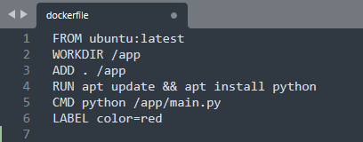
Dockerfile Example
Command to build dockerfile:
~ docker build –t <tag_name> dockerfile
~ docker build –t <tag_name> <git_repo_name>
~ docker build –t <tag_name> .

Slide 23
Dockerfile Best Practices
Create ephemeral containers.
Understand build context.
Pipe dockerfile through stdin.
Exclude with .dockerignore.
Use multi-stage build.
Don’t install unnecessary packages.
Decouple applications.
Minimize the number of layers.
Write Instruction which are going to change frequently at the bottom of the dockerfile.
We can use git hub as code repository to store docker file. And Docker hub to store docker image.
ADD . /app
RUN apt update && apt install python
CMD python /app/main.py
LABEL color=red

Slide 24
Dockerfile Mult-Stage Build.
In a traditional build, all build instructions are executed in sequence, and in a single build container: downloading dependencies, compiling code, and packaging the application. All those layers end up in your final image. This approach works, but it leads to bulky images carrying unnecessary weight and increasing your security risks. This is where multi-stage builds come in.
Multi-stage builds introduce multiple stages in your Dockerfile, each with a specific purpose. Think of it like the ability to run different parts of a build in multiple different environments, concurrently. By separating the build environment from the final runtime environment, you can significantly reduce the image size and attack surface. This is especially beneficial for applications with large build dependencies.
ADD . /app
RUN apt update && apt install python
CMD python /app/main.py
LABEL color=red

Slide 25
Thank You !

